Slide 1

PROJECT-1
IBM HR Analytics: Predicting Employee Attrition & Performance
Leveraging data to make strategic HR decisions. This presentation introduces IBM's HR Analytics dataset and its value for workforce management.
MT
by MANKAR KRISHNA TANMAYEE

Slide 2
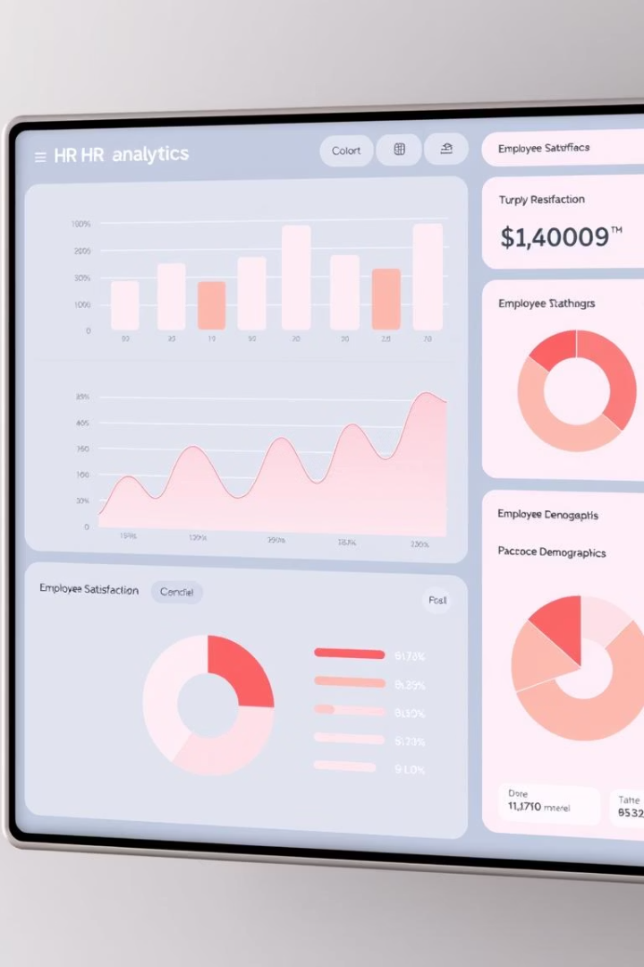
Understanding the IBM HR Analytics Dataset
Dataset Source
Fictional data created by IBM data scientists for HR research.
Key Features
Demographics and Job Satisfaction
Performance Ratings
Work-Life Balance
Dataset Details
1470 employees, 35 features. Target variable is Attrition (Yes/No).
Data Quality
Emphasizes importance of preprocessing and clean data.

Slide 3
Exploratory Data Analysis: Unveiling Insights
Problem Statement
Employee attrition impacts organizational stability, productivity, and culture, often resulting in high recruitment costs and lost expertise. The underlying reasons for departures frequently remain unknown until it's too late. This project analyzes HR data to identify key attrition drivers and support proactive retention strategies.
Objective
Tools Used
Discover patterns and anomalies in employee data.
Python libraries: Pandas, NumPy, Matplotlib, Seaborn.
.

Slide 4
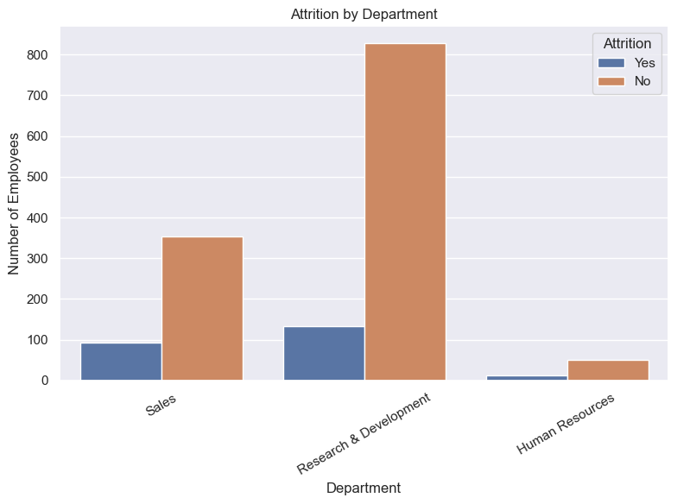
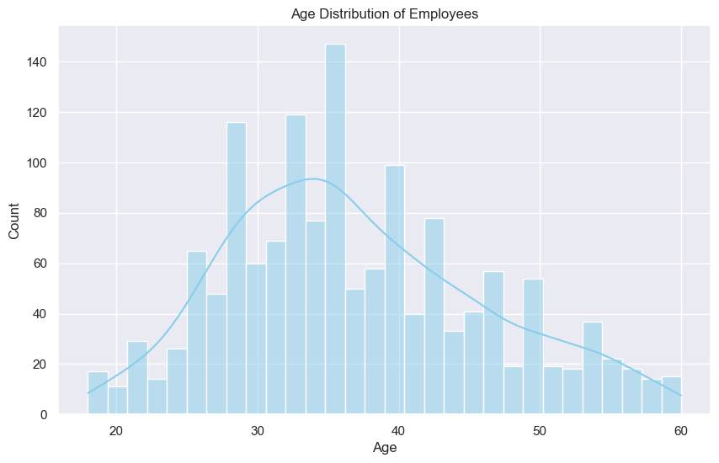
Visualizing Attrition Factors
Attrition by Department
Age Distribution by Attrition
R&D shows highest attrition, followed by Sales and HR.
Younger employees are more likely to leave the company.

Slide 5
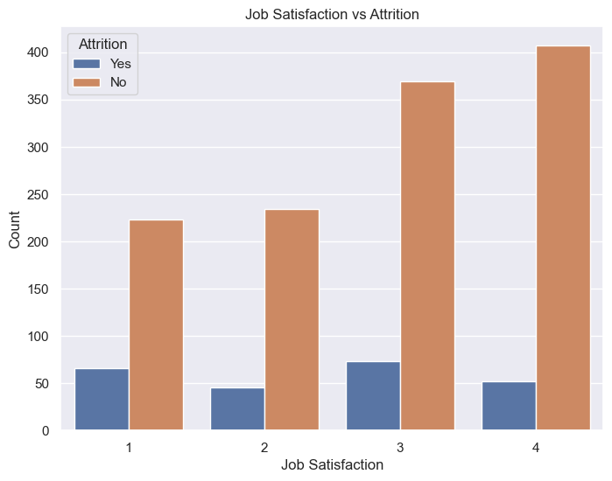
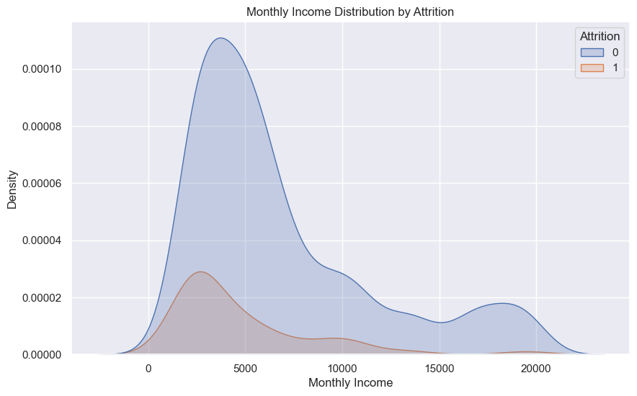
Performance and Job Satisfaction Analysis
Job Satisfaction & Performance
Monthly Income Distribution by Attrition
Lower satisfaction often coincides with higher attrition risk.
Attrited employees tend to earn less than those retained.

Slide 6
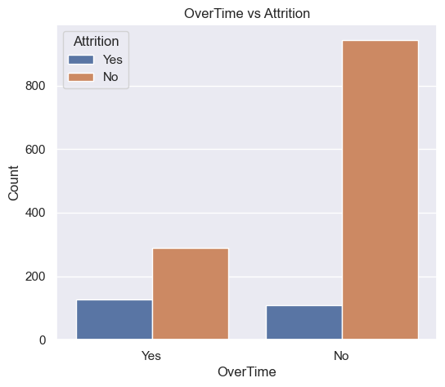


Work-Life Balance & Attrition
Attrition & Work-Life Balance
Poor balance increases employee turnover rates.
Overtime Impact
Employees working more overtime show higher attrition likelihood.

Slide 7

Building Predictive Models
1
Algorithms Used
2
Evaluation Metrics
3
Model Performance
Random Forest.
Accuracy, Precision, Recall, F1-score, Confusion_matrix.
Random Forest achieved 84% accuracy in attrition prediction.

Slide 8




Feature Importance: Key Attrition Drivers
Job Satisfaction
Years at Company
Lower satisfaction increases attrition risk.
Longer tenure generally reduces attrition chances.
Overtime
Monthly Income
Strongest indicator of potential attrition.
Higher income linked with employee retention.
2
3
1
4

Slide 9

Actionable Insights & Recommendations
Improve Work-Life Balance
Reduce overtime and offer flexible scheduling.
Enhance Job Satisfaction
Boost compensation and provide career growth.
Focus Retention Programs
Target younger employees and high-risk departments.
Continuous Monitoring
Track attrition trends to adjust strategies promptly.

Slide 10

Conclusion: Data-Driven HR for Retention
Empower Decisions
Use data to guide HR strategy effectively.
Proactive Management
Identify and address attrition risks early.
Optimize Engagement
Drive better performance and satisfaction.
Continuous Improvement
Regularly refine HR initiatives with analytics.

